Slide 1
Microservice

Slide 2
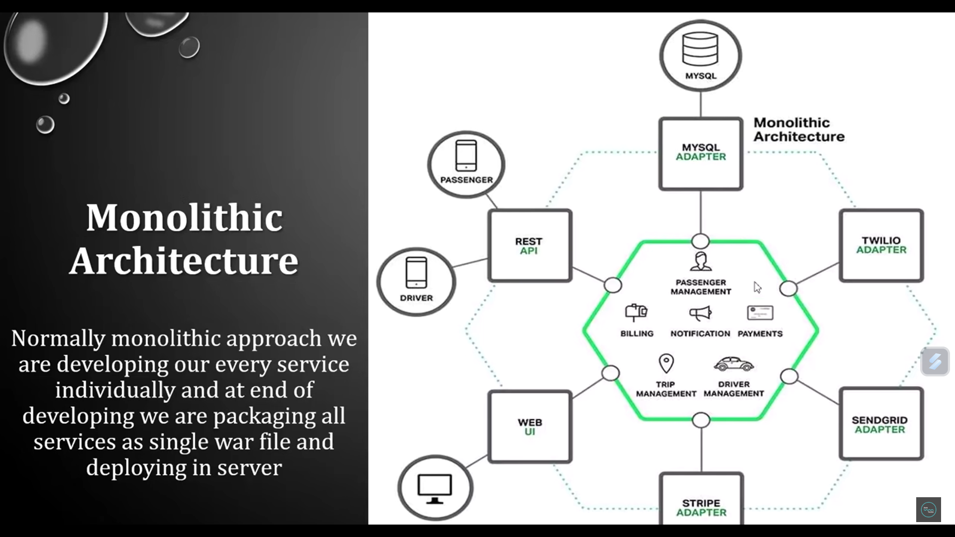

Slide 3
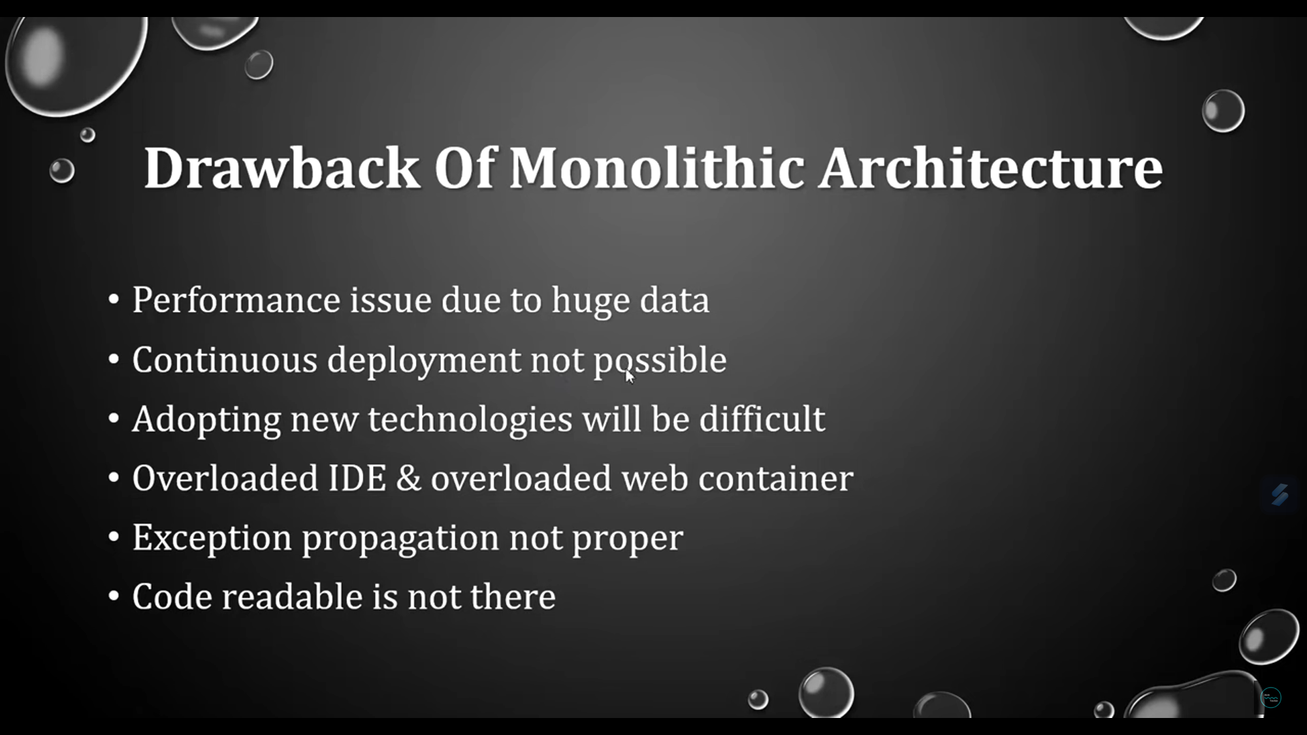

Slide 4
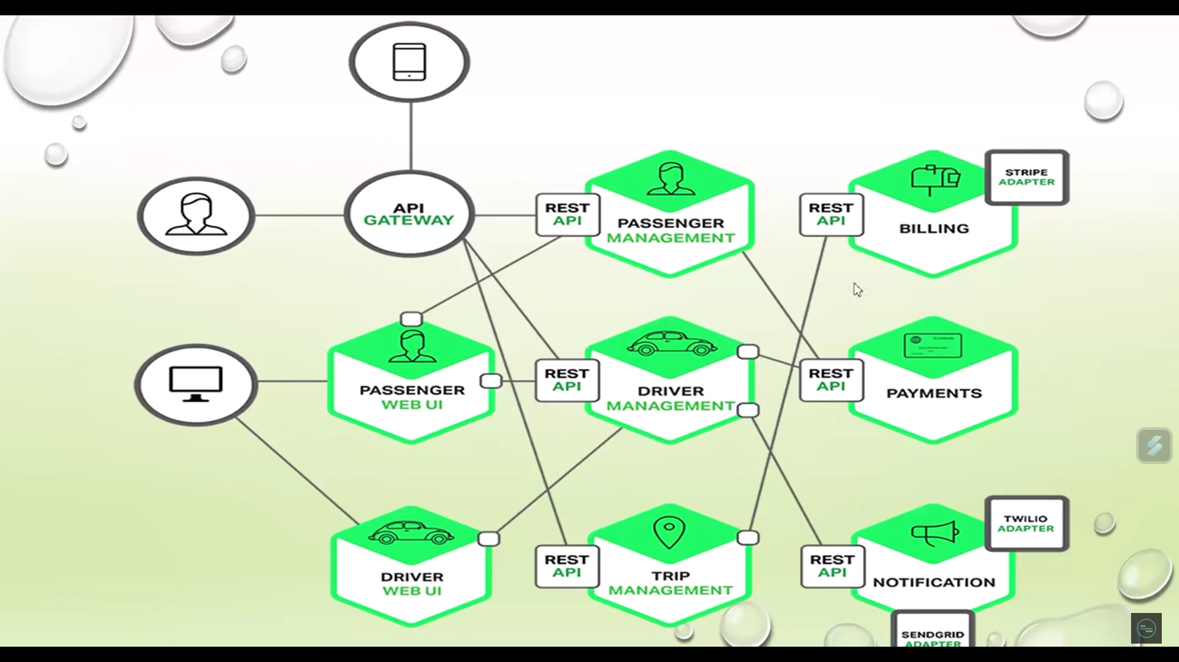

Slide 5
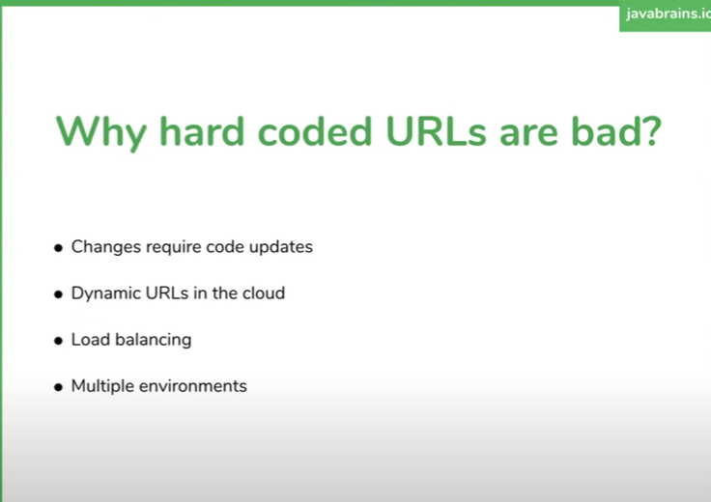

Slide 6
Microservices Service Registry
A service registry is a database used to keep track of the available instances of each microservice in an application. The service registry needs to be updated each time a new service comes online and whenever a service is taken offline or becomes unavailable. This can be achieved with either self-registration or third-party registration.

Slide 7
Self-Registration
With self-registration, each microservice is responsible for adding itself to the service registry when it comes online. Typically, the service registry exposes a REST API for this purpose. Each instance registers itself with a POST request and can remove itself with a DELETE request. As a fail-safe, service instances can send a heartbeat to the service registry to indicate that they are still online and available. If the heartbeat stops, this indicates that the instance is either offline or not responding, and the instance can be de-registered.
While self-registration is a simple design, it does require you to implement the registration logic in every language or framework that you use for your microservices.

Slide 8
Third-Party Registration
Third-party registration offers a more loosely coupled solution: a service registrar (also known as a service manager) is responsible for registering each new instance as it comes online and de-registering it when it becomes unavailable. The service registrar does this by polling the deployment environment for updates or subscribing to event notifications.
While this may sound like a lot of overhead, deployment environments such as Kubernetes and Amazon EC2 come with a built-in service registry and third-party service registrar, saving you the effort of implementing and maintaining another highly available component.

Slide 9
Discovering Services
In order to send an API request to a service, the client or API gateway must know the location of the service that its addressing. As the microservice architecture is designed to support multiple instances of each service, service discovery is closely linked to load balancing of requests to instances of each microservice.

Slide 10
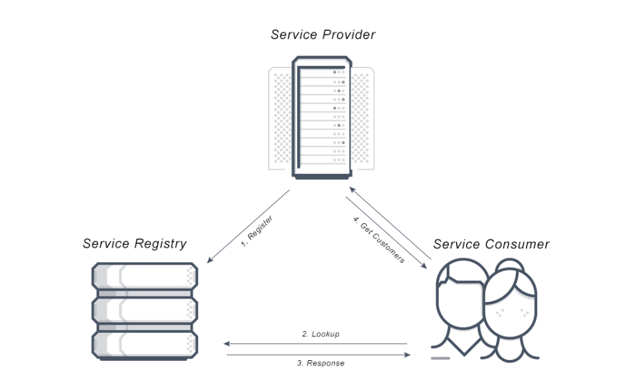
Service discovery
Service discovery is the process of automatically detecting devices and services on a network.
Service discovery provides a mechanism for keeping track of the available instances and distributing requests across available instances.

Slide 11
Service discovery
Service Discovery is a design pattern by which the Client or the API Gateways discover the network info (IP address and port) of the Server through an important component called Service Registry or Discovery Server.
https://springframework.guru/eureka-service-registry/

Slide 12
How does Service Discovery Work?
There are three components to Service Discovery: the service provider, the service consumer and the service registry.
1) The Service Provider registers itself with the service registry when it enters the system and de-registers itself when it leaves the system.
2) The Service Consumer gets the location of a provider from the service registry, and then connects it to the service provider.
3) The Service Registry is a database that contains the network locations of service instances. The service registry needs to be highly available and up to date so clients can go through network locations obtained from the service registry. A service registry consists of a cluster of servers that use a replication protocol to maintain consistency.

Slide 13
Client Side Service Discovery
With client-side discovery, the client or API gateway making the request is responsible for identifying the location of the service instance and routing the request to it. The client begins by querying the service registry to identify the location of the available instances of the service and then determines which instance to use. The load balancing logic can be a simple round-robin approach or use a weighting system to determine the best instance to query at a given time.

Slide 14
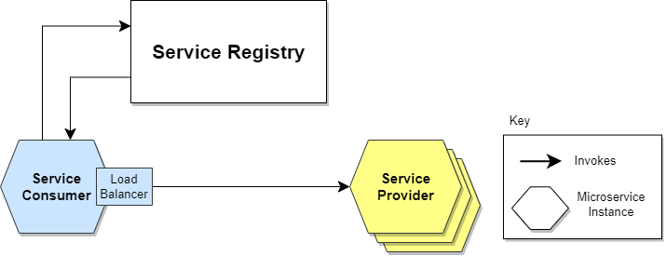
Client Side Service Discovery
Giving responsibility for client-side load balancing is both a burden and an advantage. It’s an advantage because it saves an extra hop that we would’ve had with a dedicated load balancer. It’s a disadvantage because the Service Consumer must implement the load balancing logic.

Slide 15
Server-Side Service Discovery
With server-side discovery, the client or API gateway simply passes the request, including the DNS name, to a router. The router queries the service registry (which may be a separate component or built-in to the router) to identify the available instances of the service and then applies load balancing logic to decide which one to use.

Slide 16
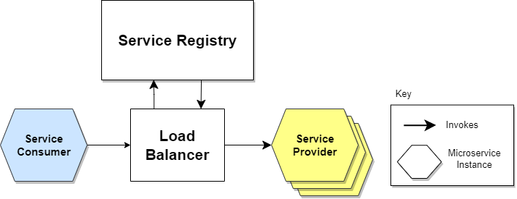
Server-Side Service Discovery

Slide 17
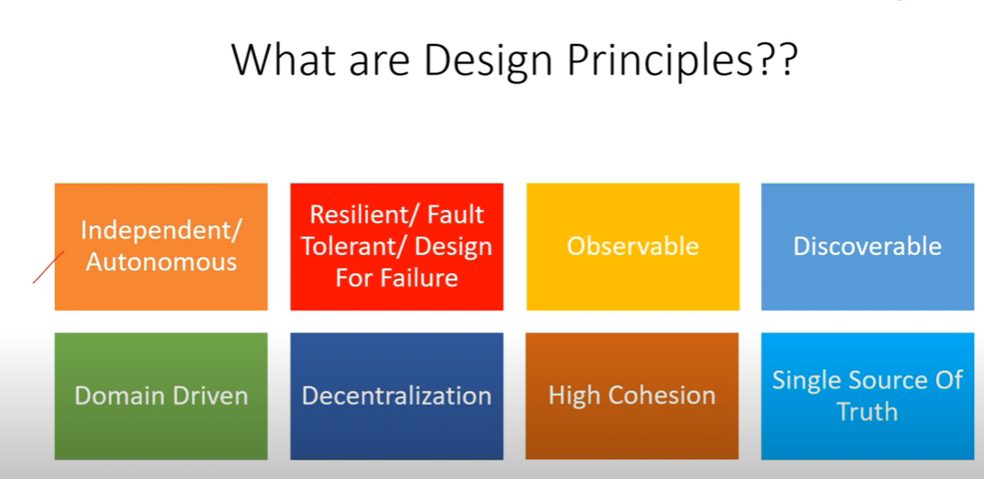

Slide 18
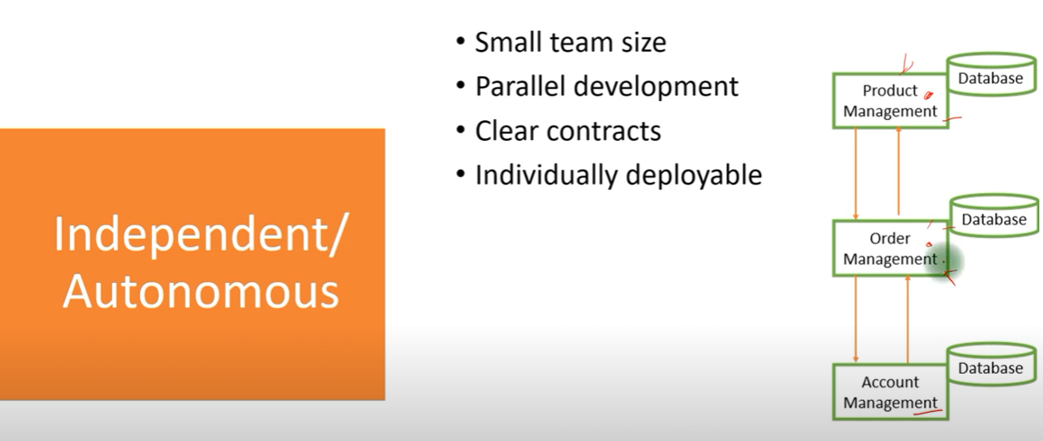

Slide 19
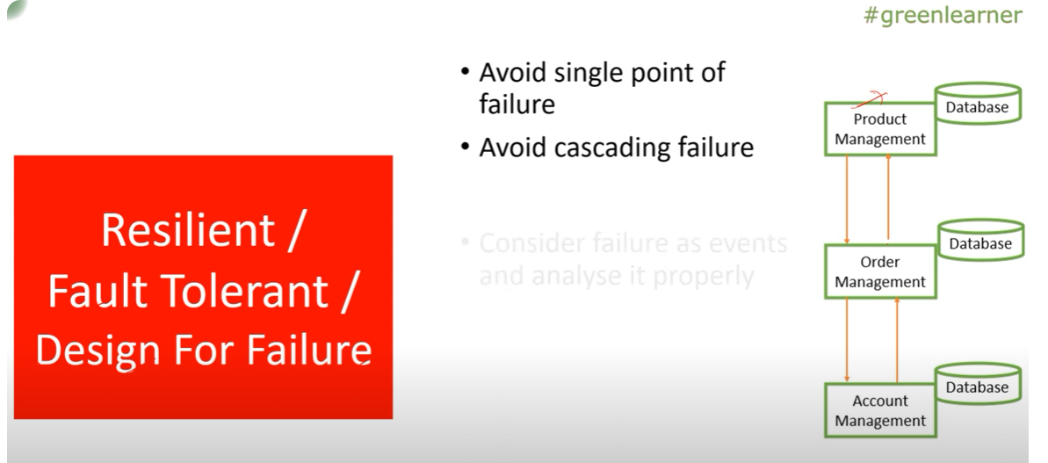

Slide 20
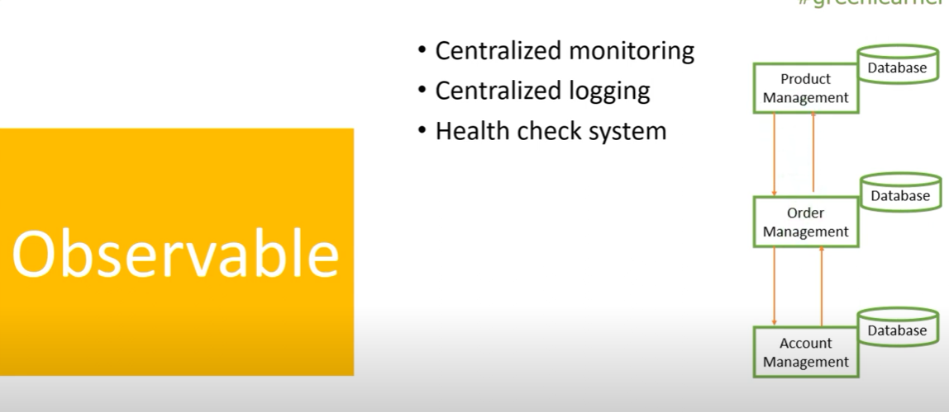

Slide 21
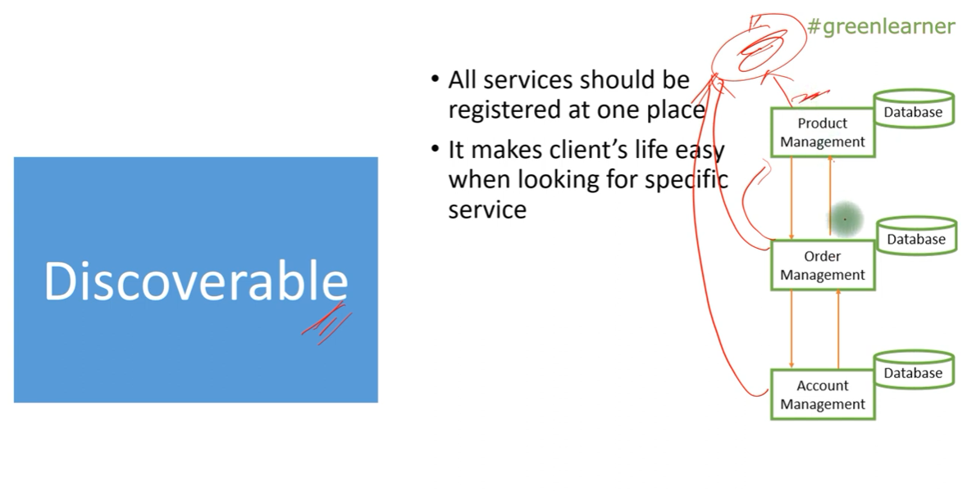

Slide 22
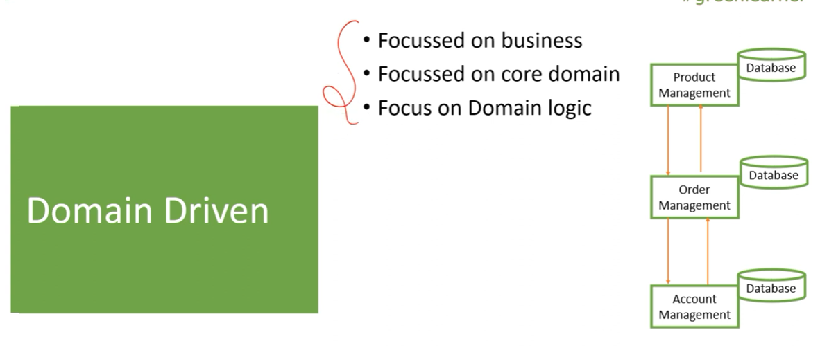

Slide 23
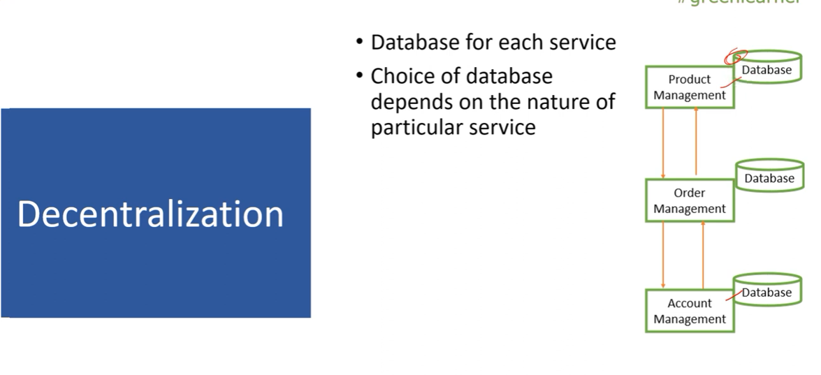

Slide 24
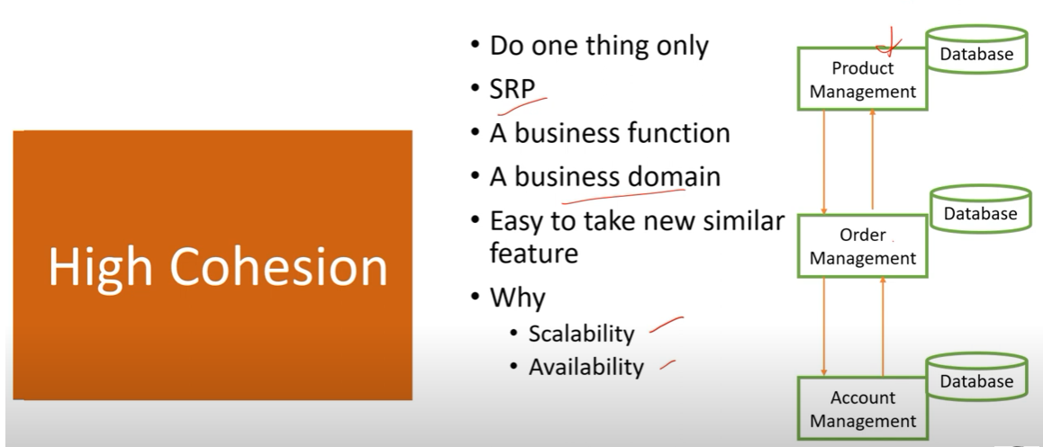

Slide 26
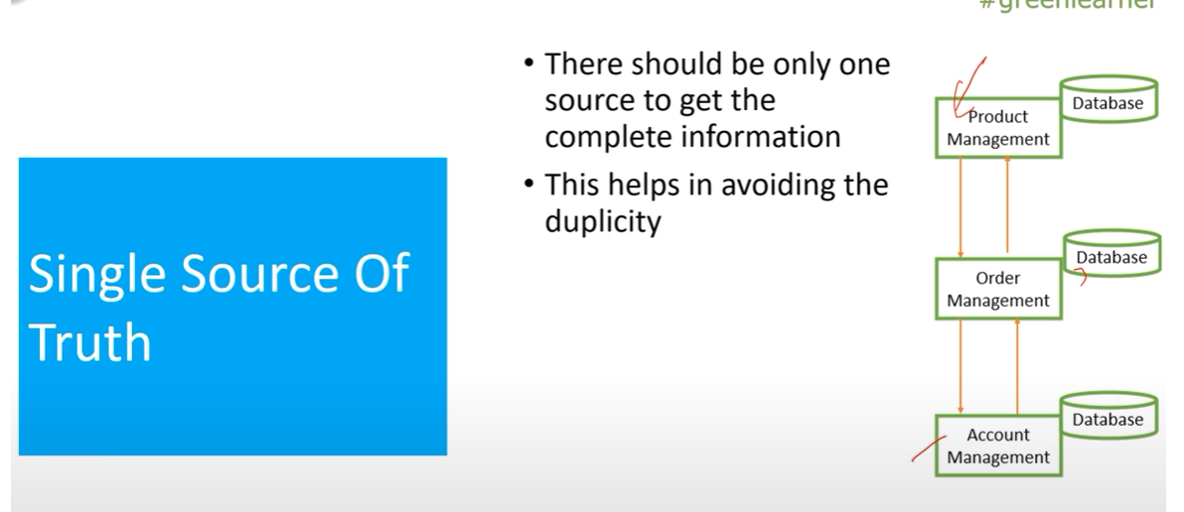

Slide 27
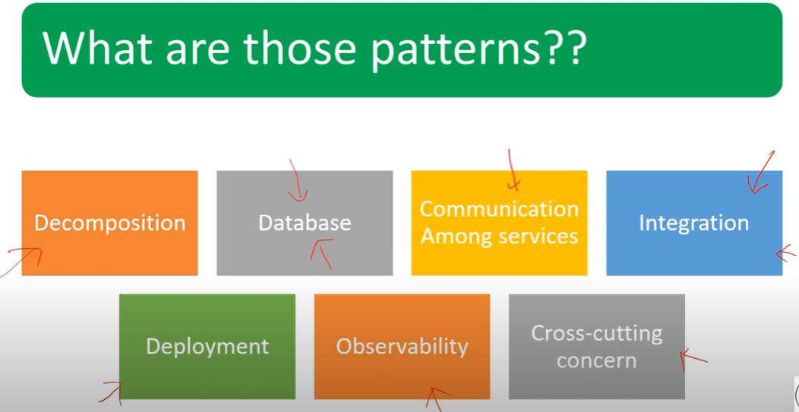

Slide 28
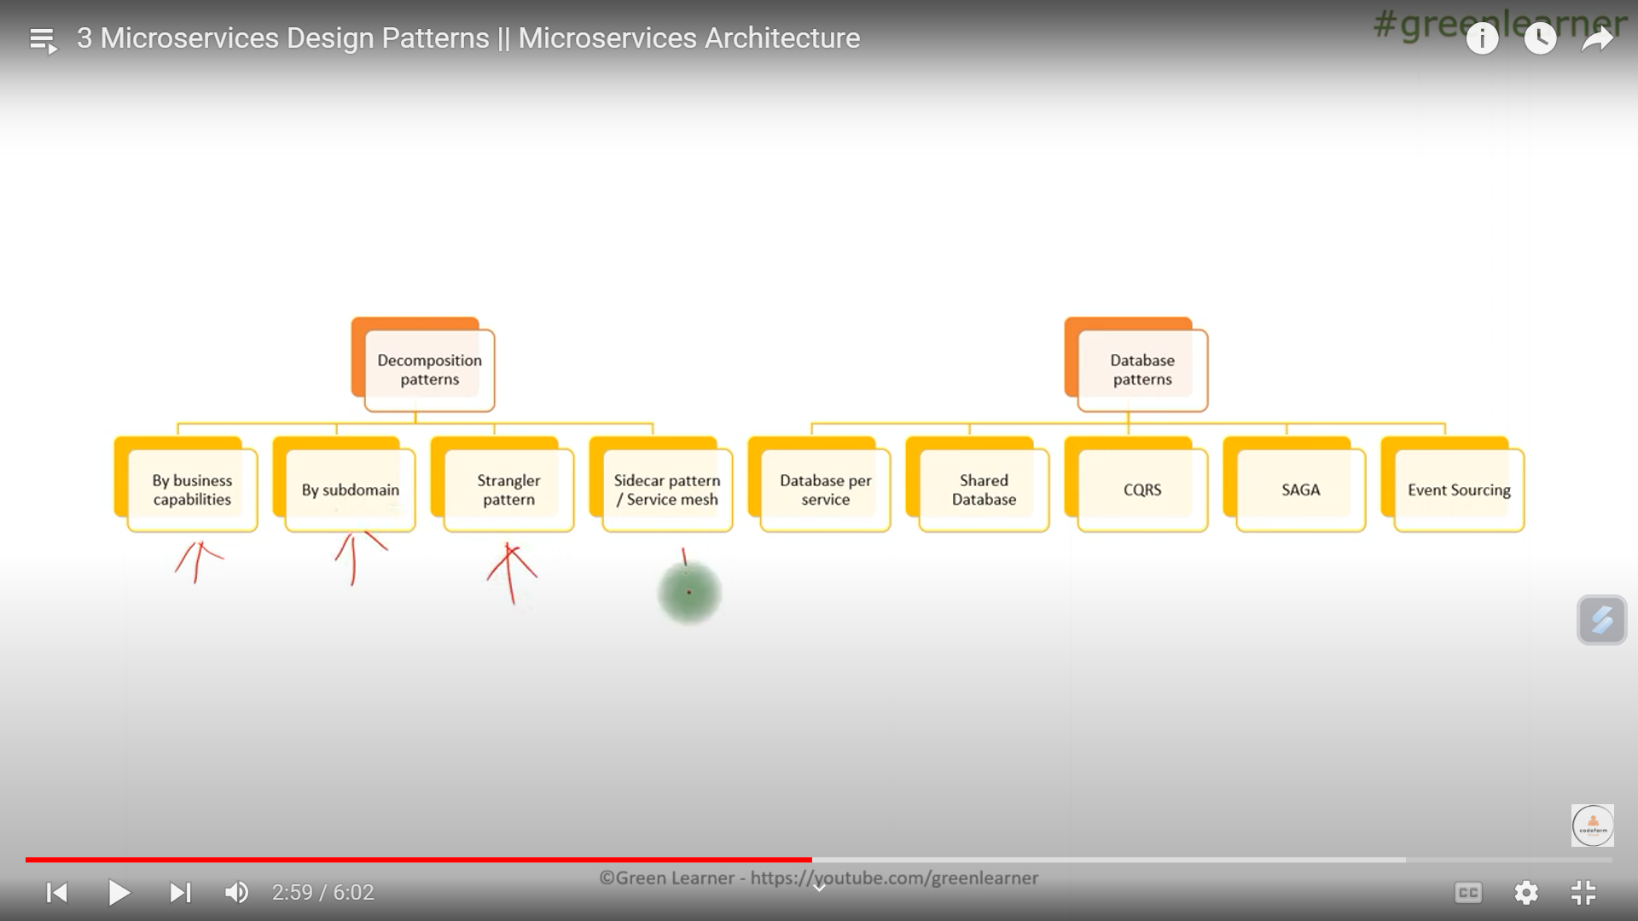

Slide 29
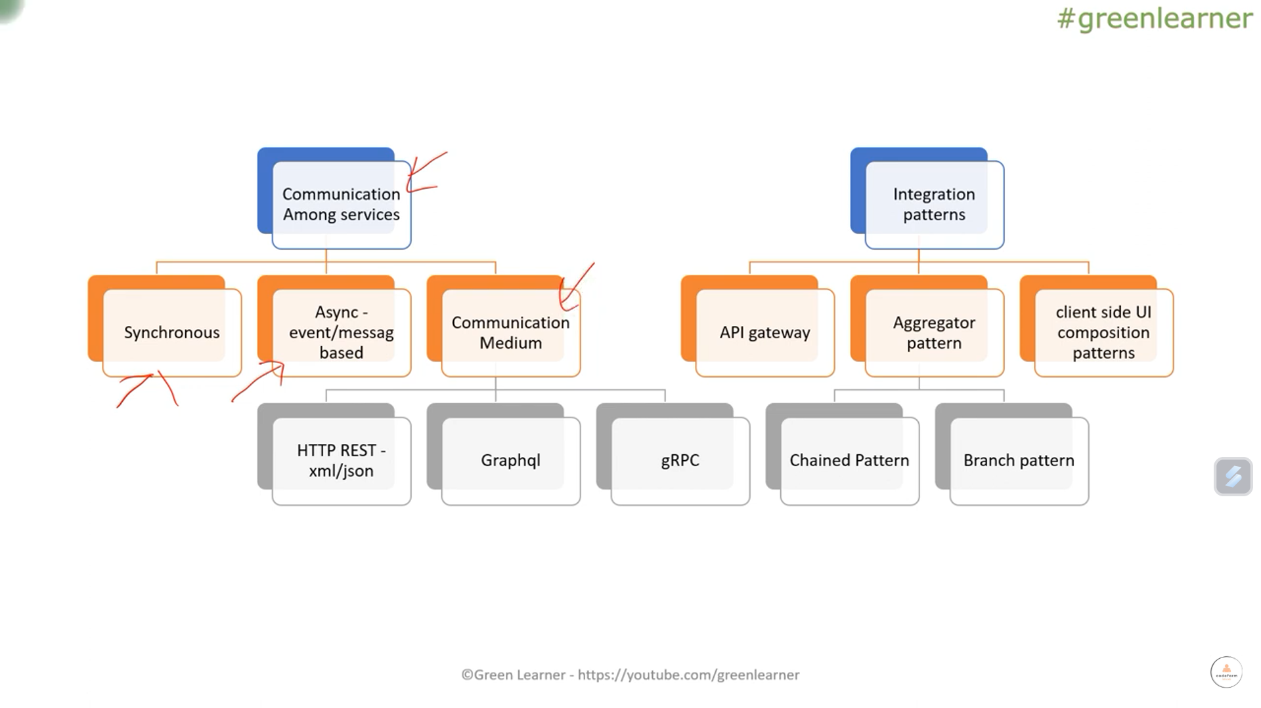

Slide 30
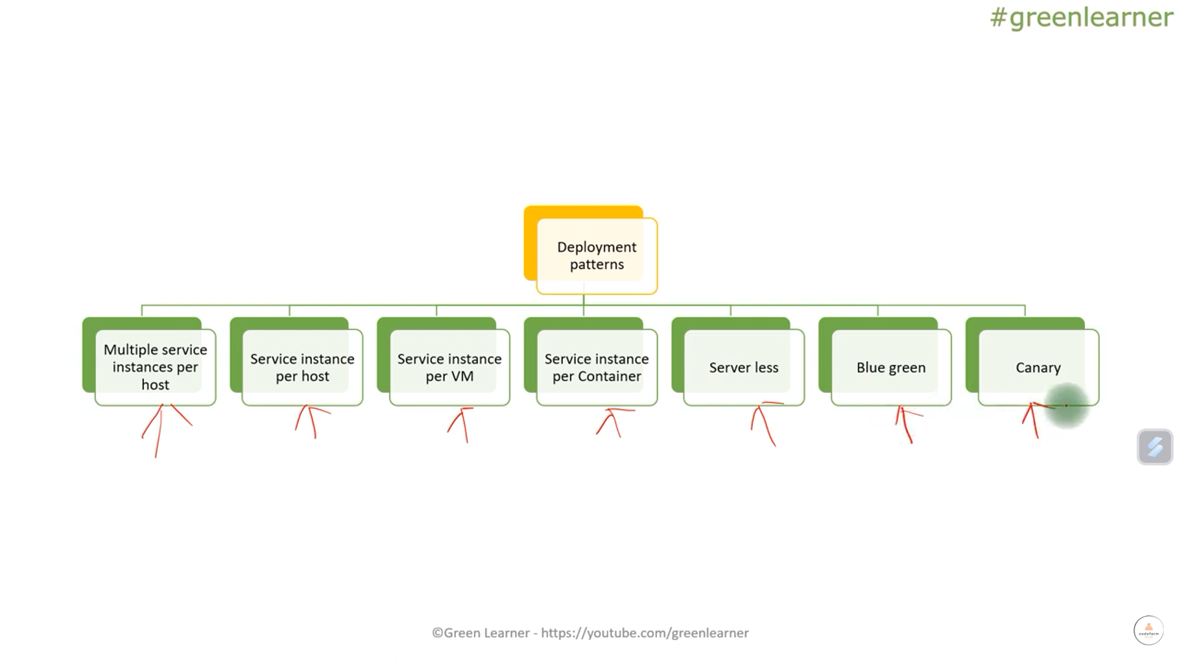

Slide 31
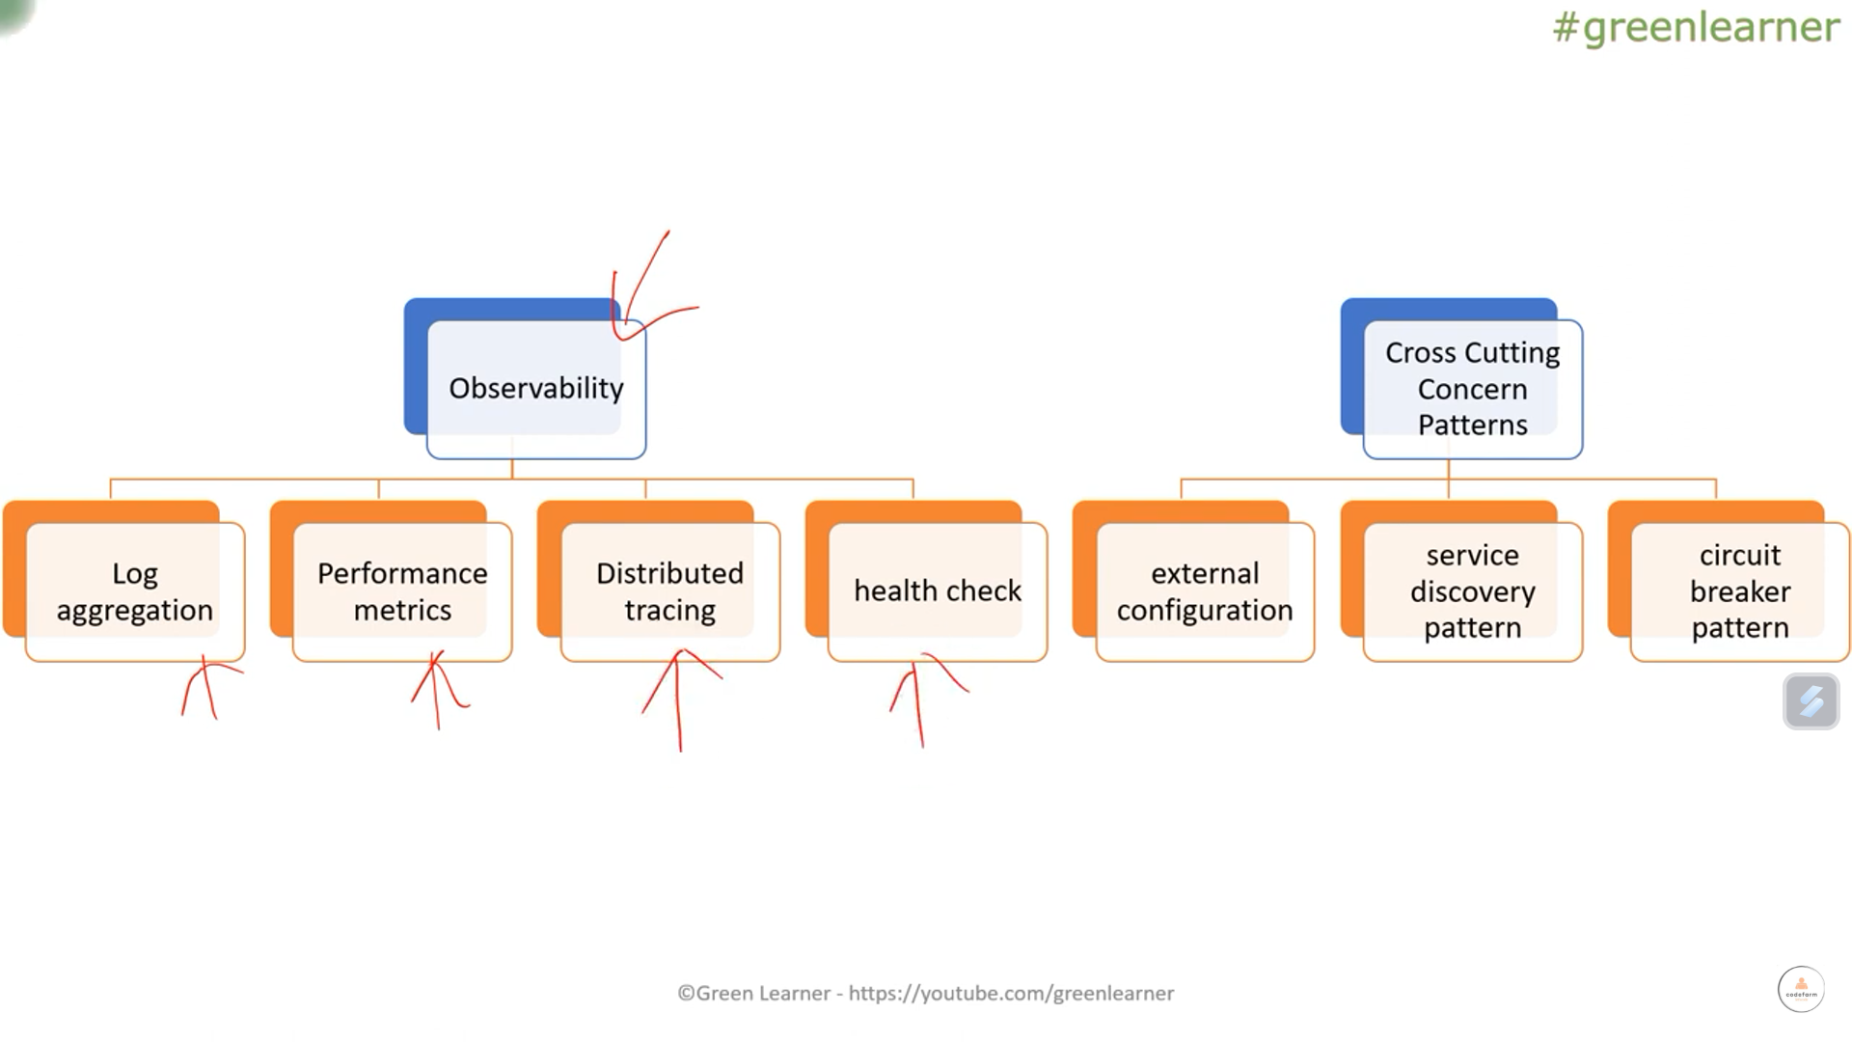

Slide 32
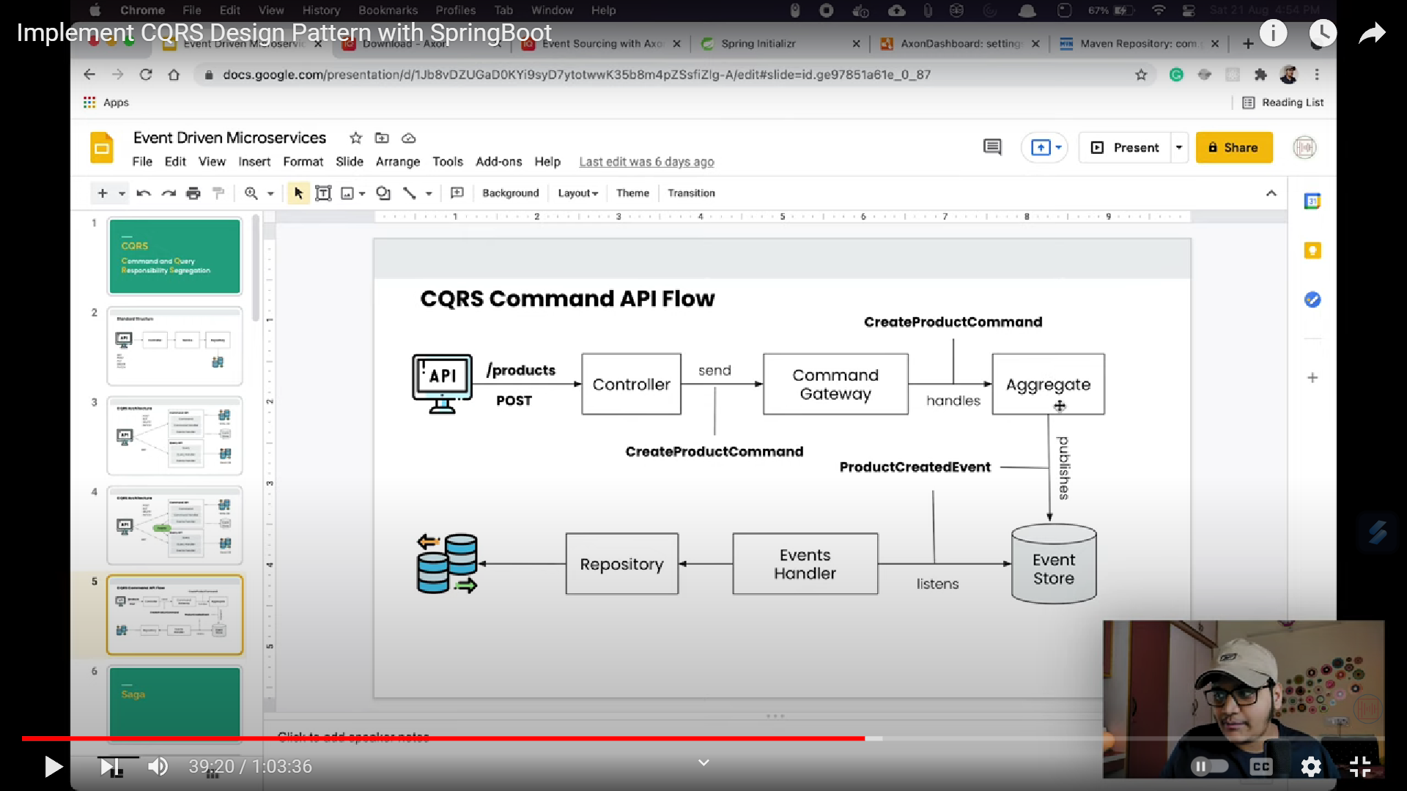

Slide 33


Slide 34
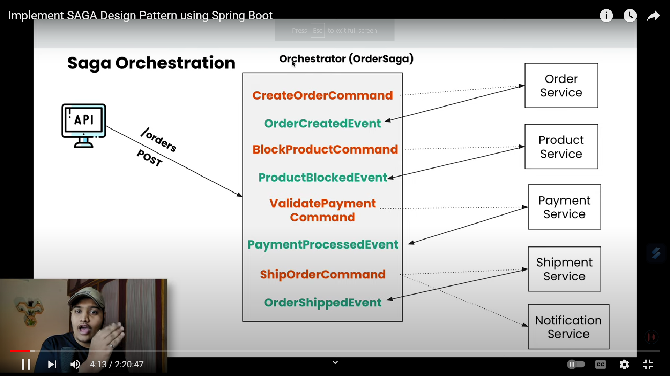

Slide 35
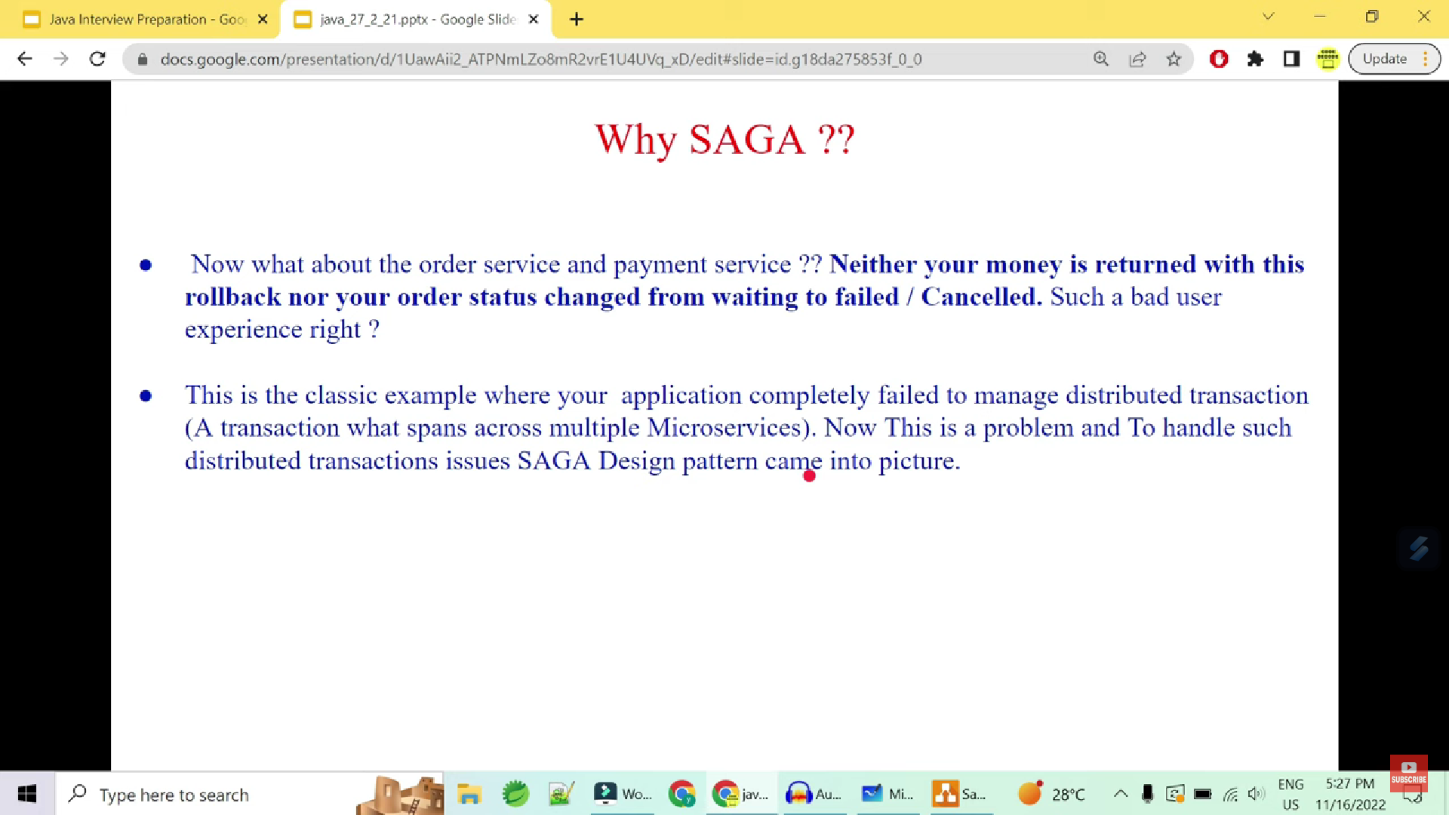

Slide 36
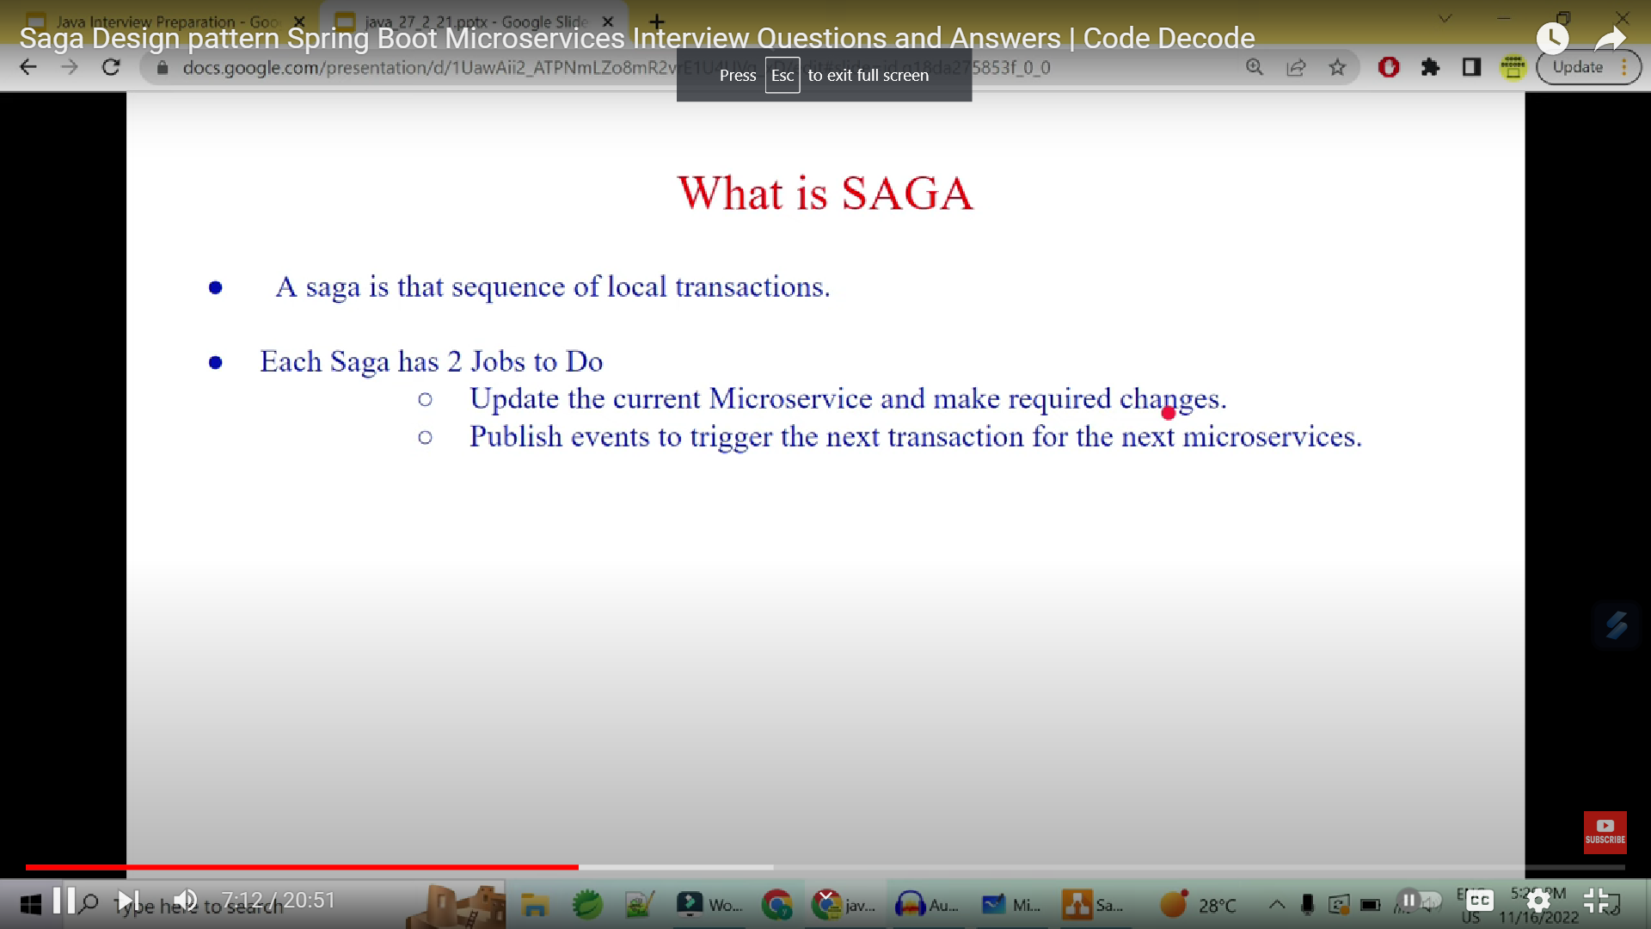

Slide 37
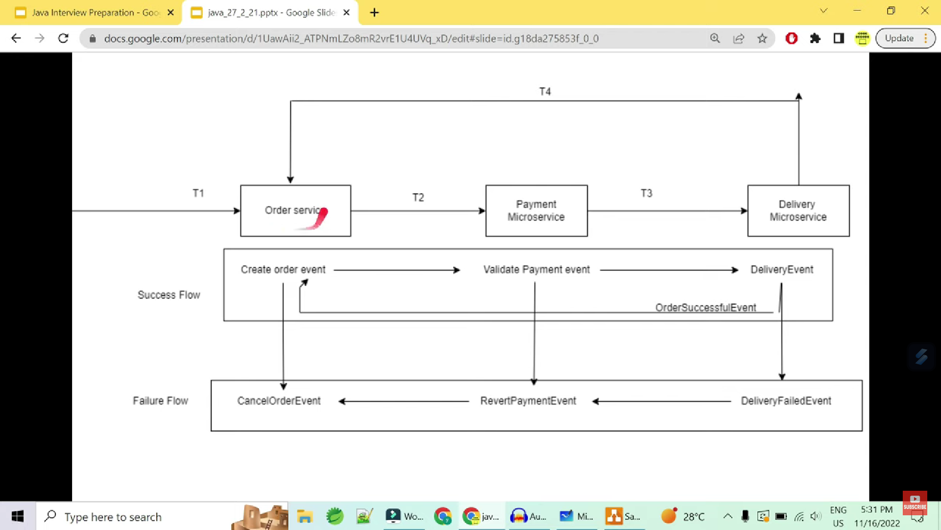

Slide 38
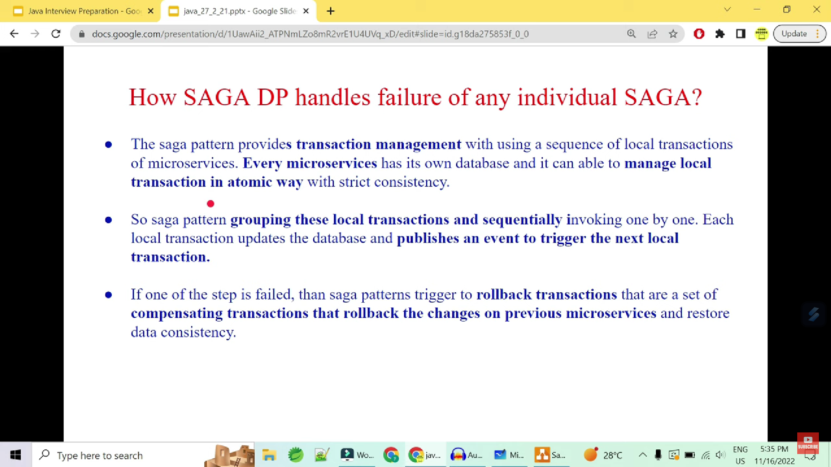

Slide 39
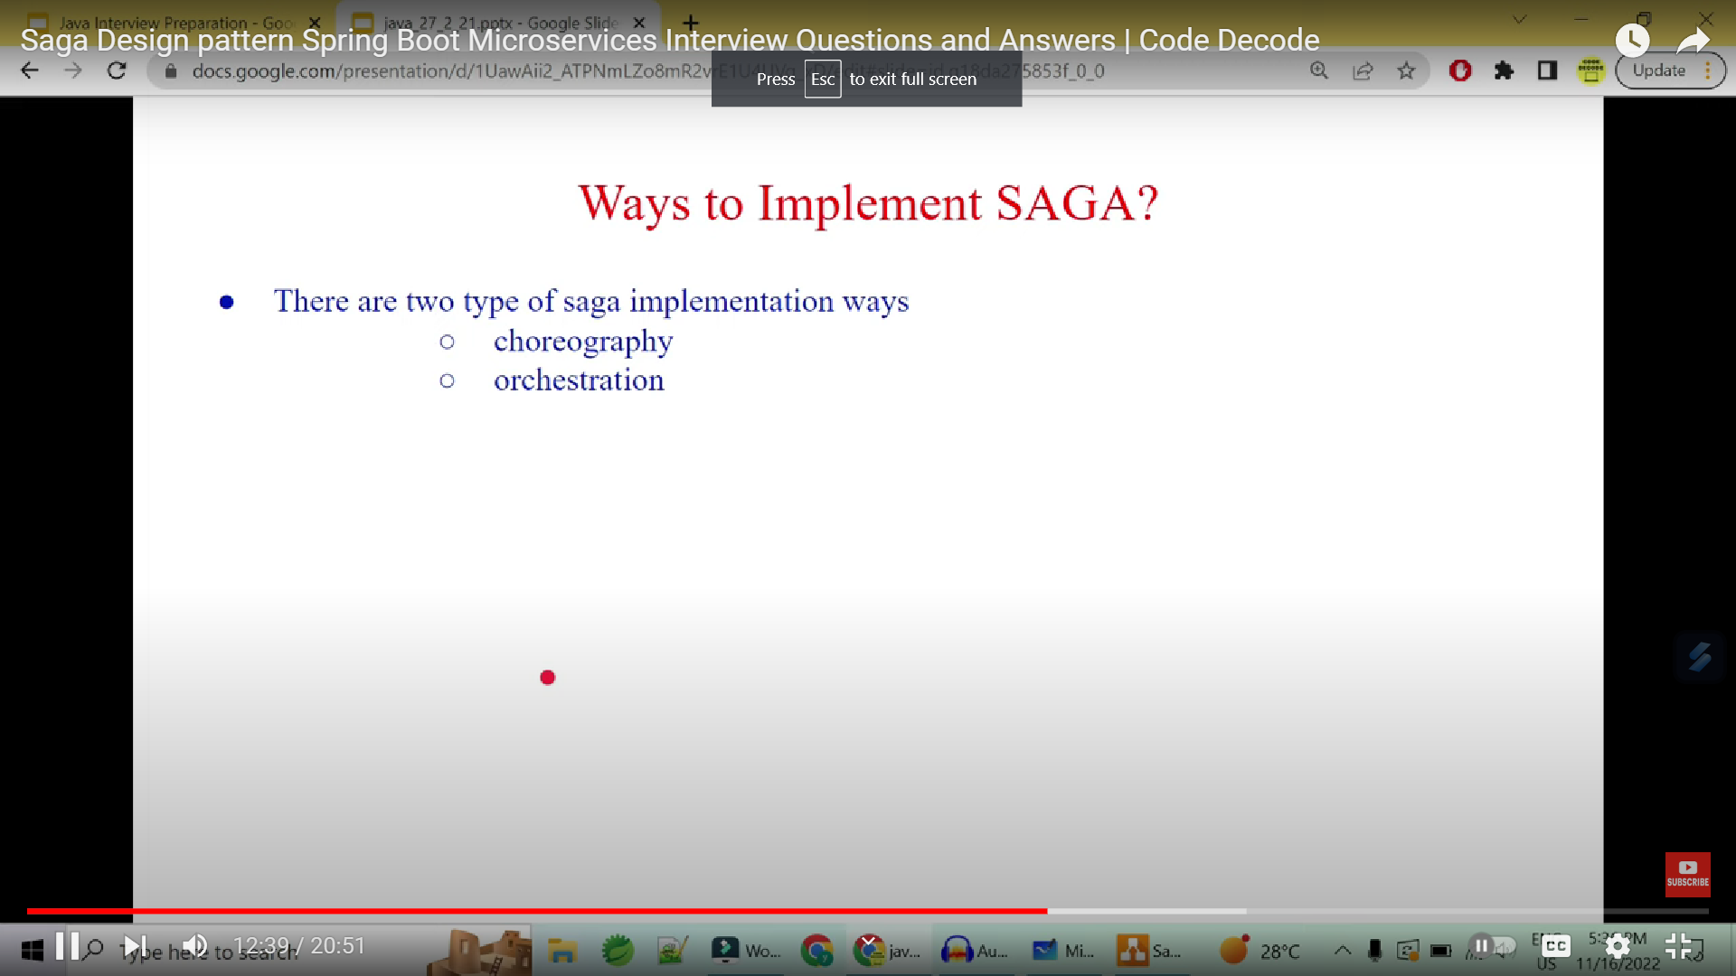

Slide 40
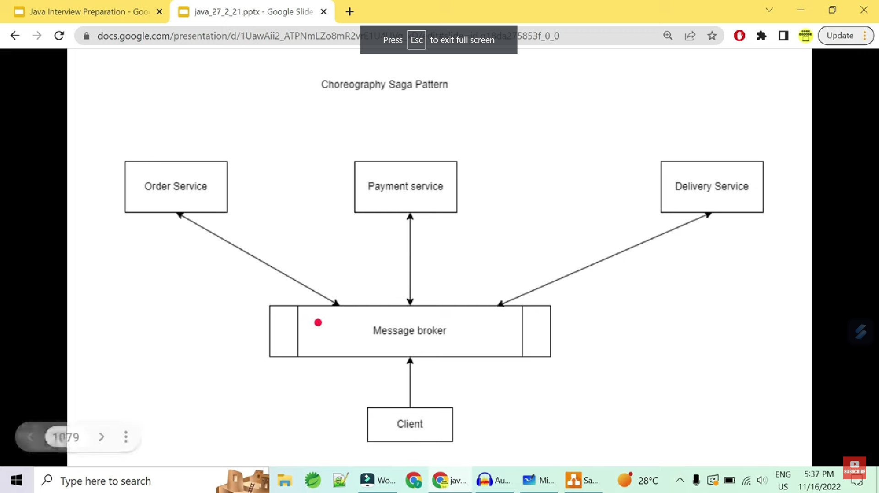

Slide 41


Slide 42
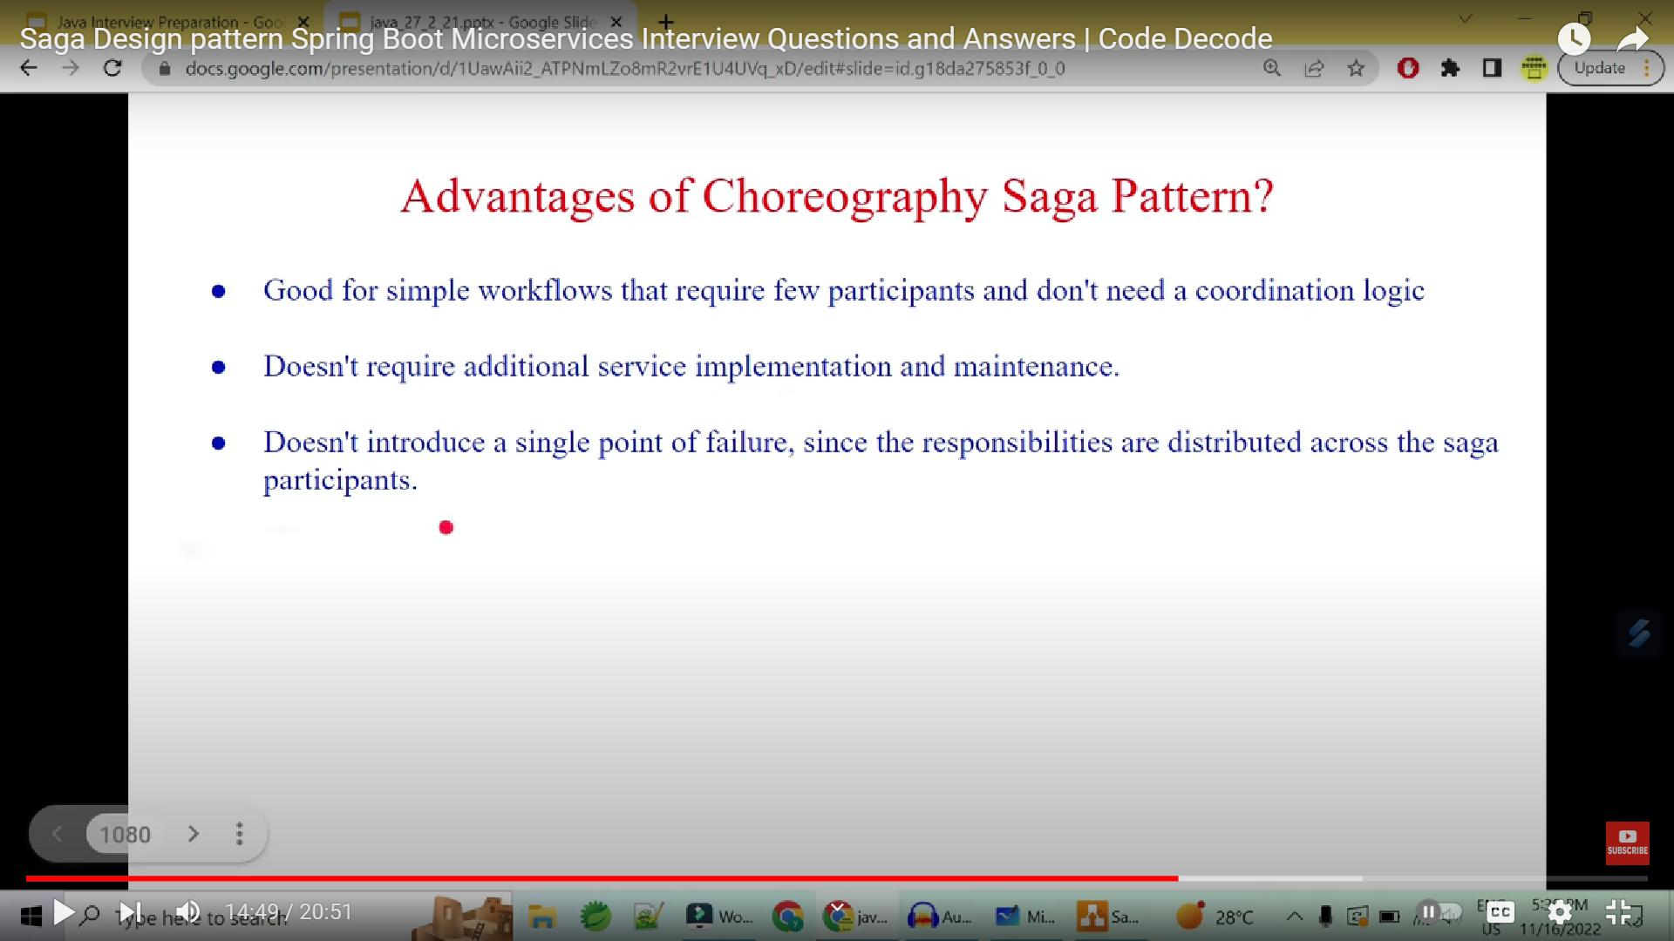

Slide 43
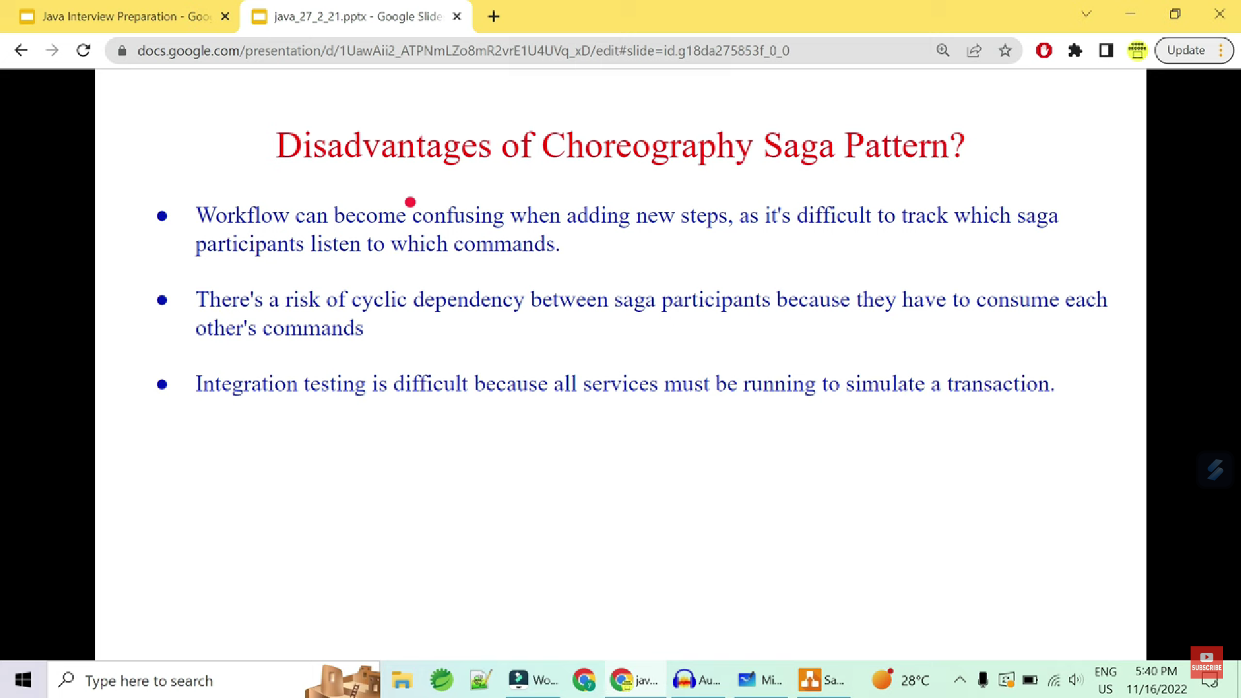

Slide 44
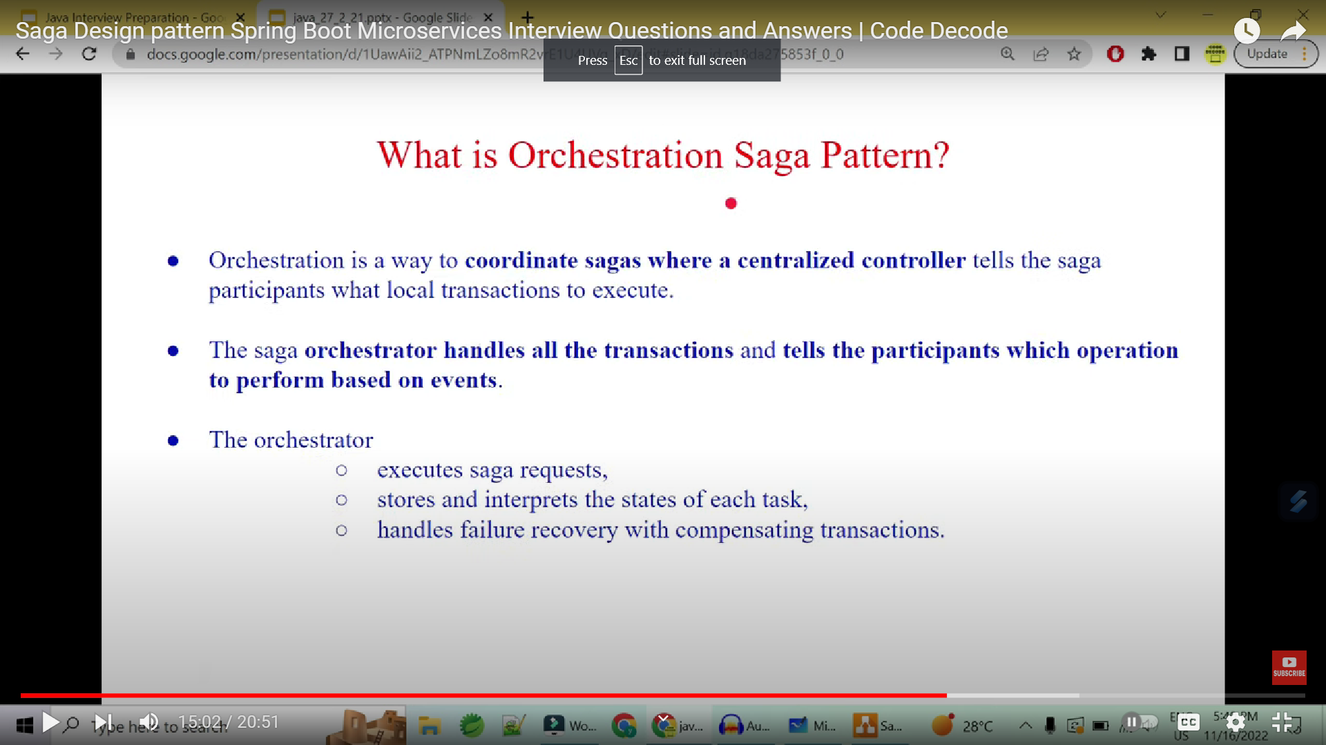

Slide 45
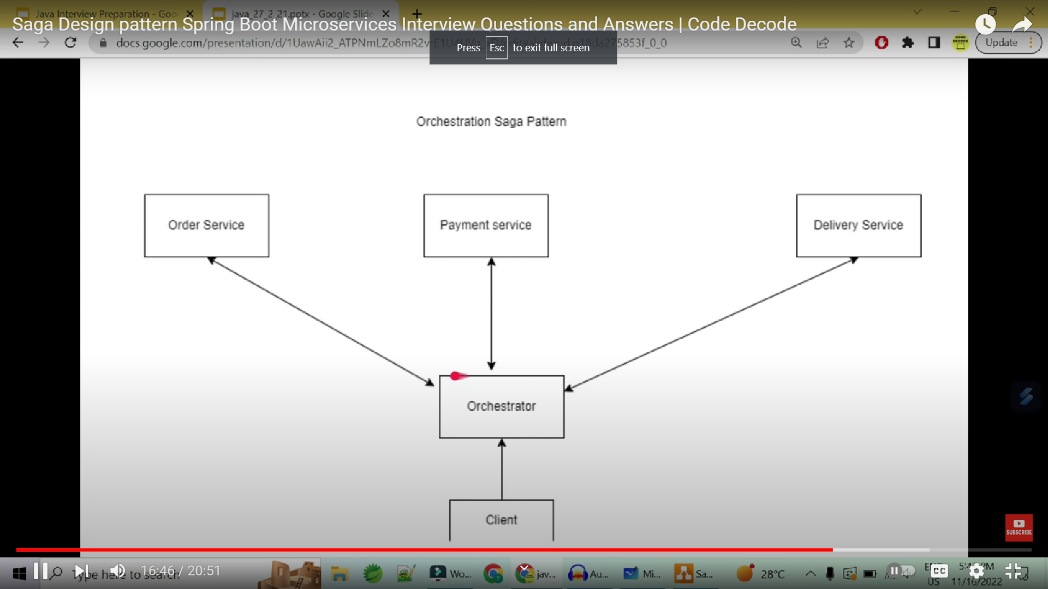

Slide 46
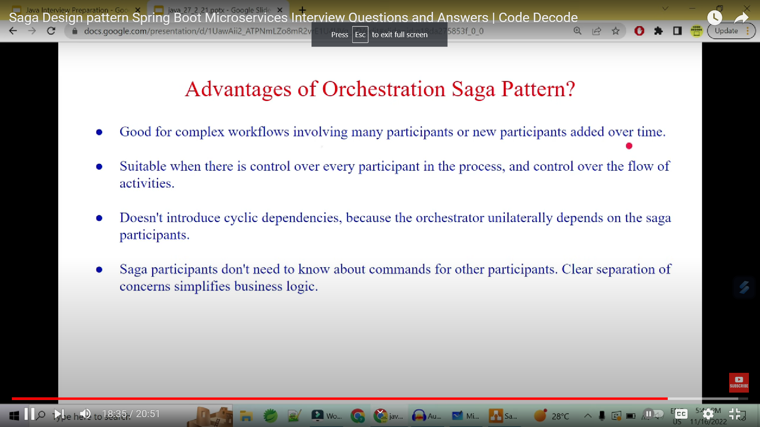

Slide 47
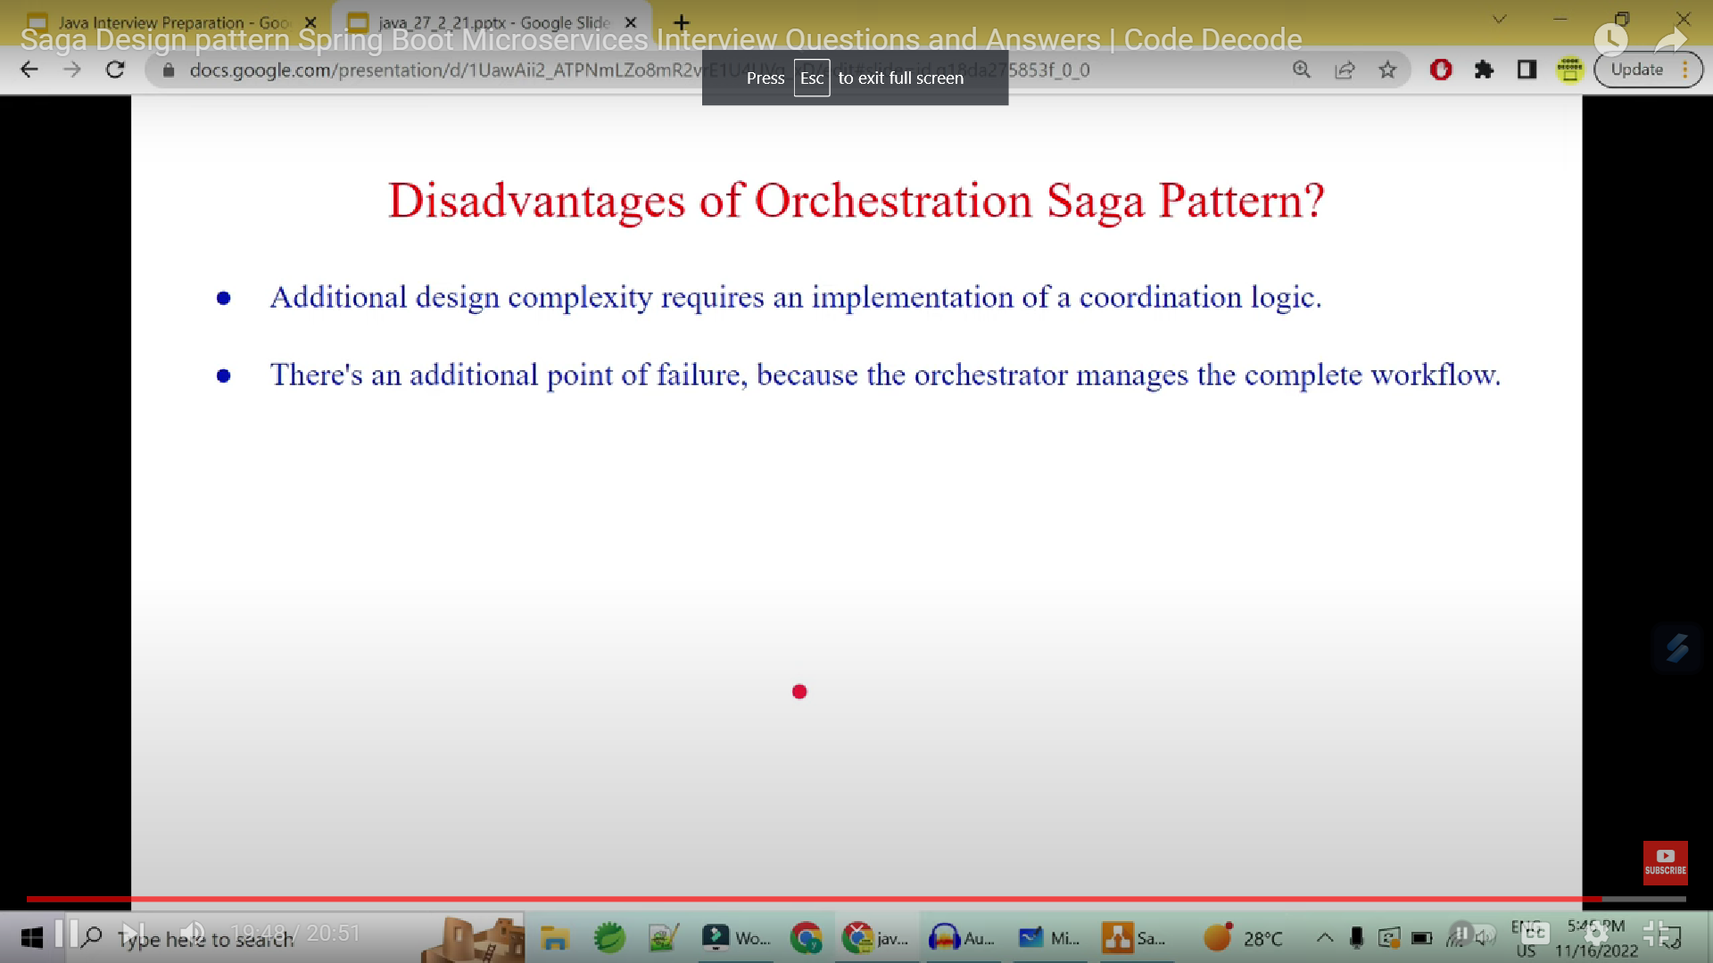

Slide 48
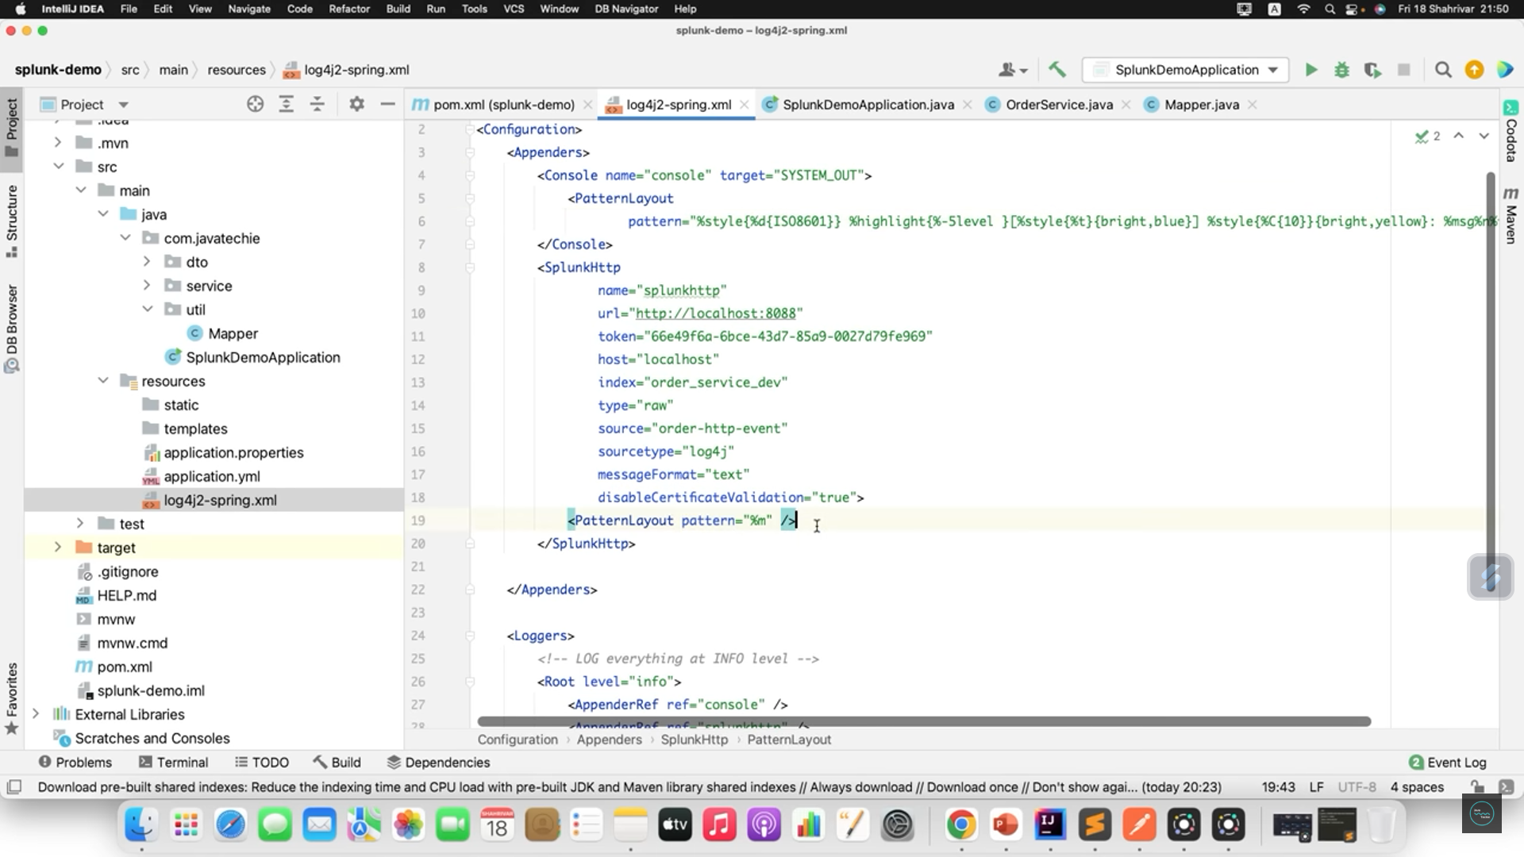

Slide 49
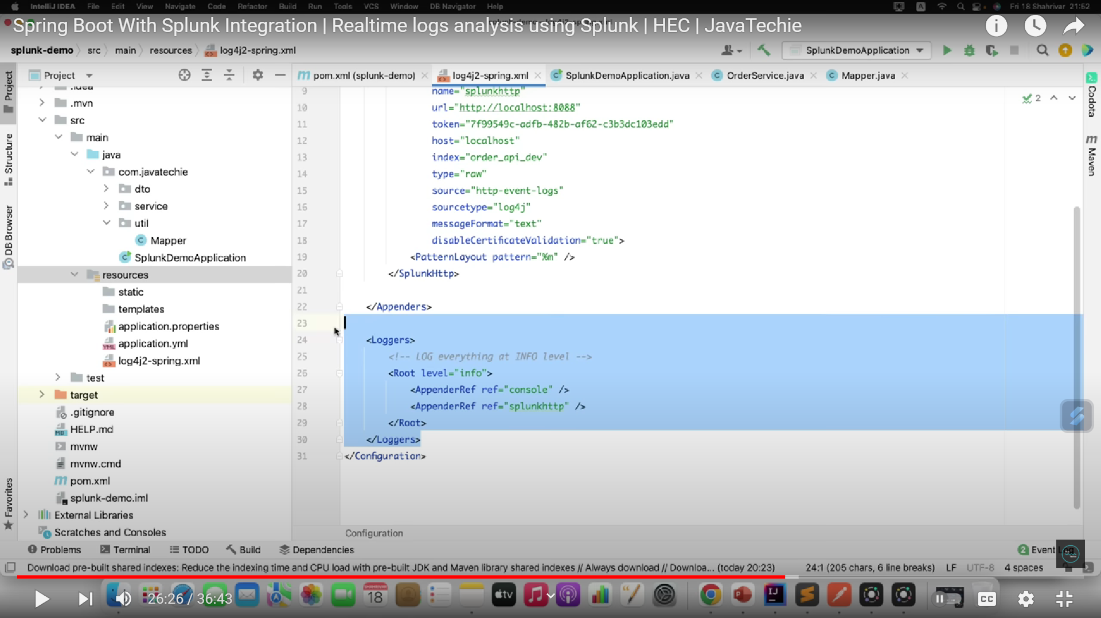

Slide 50


Slide 51
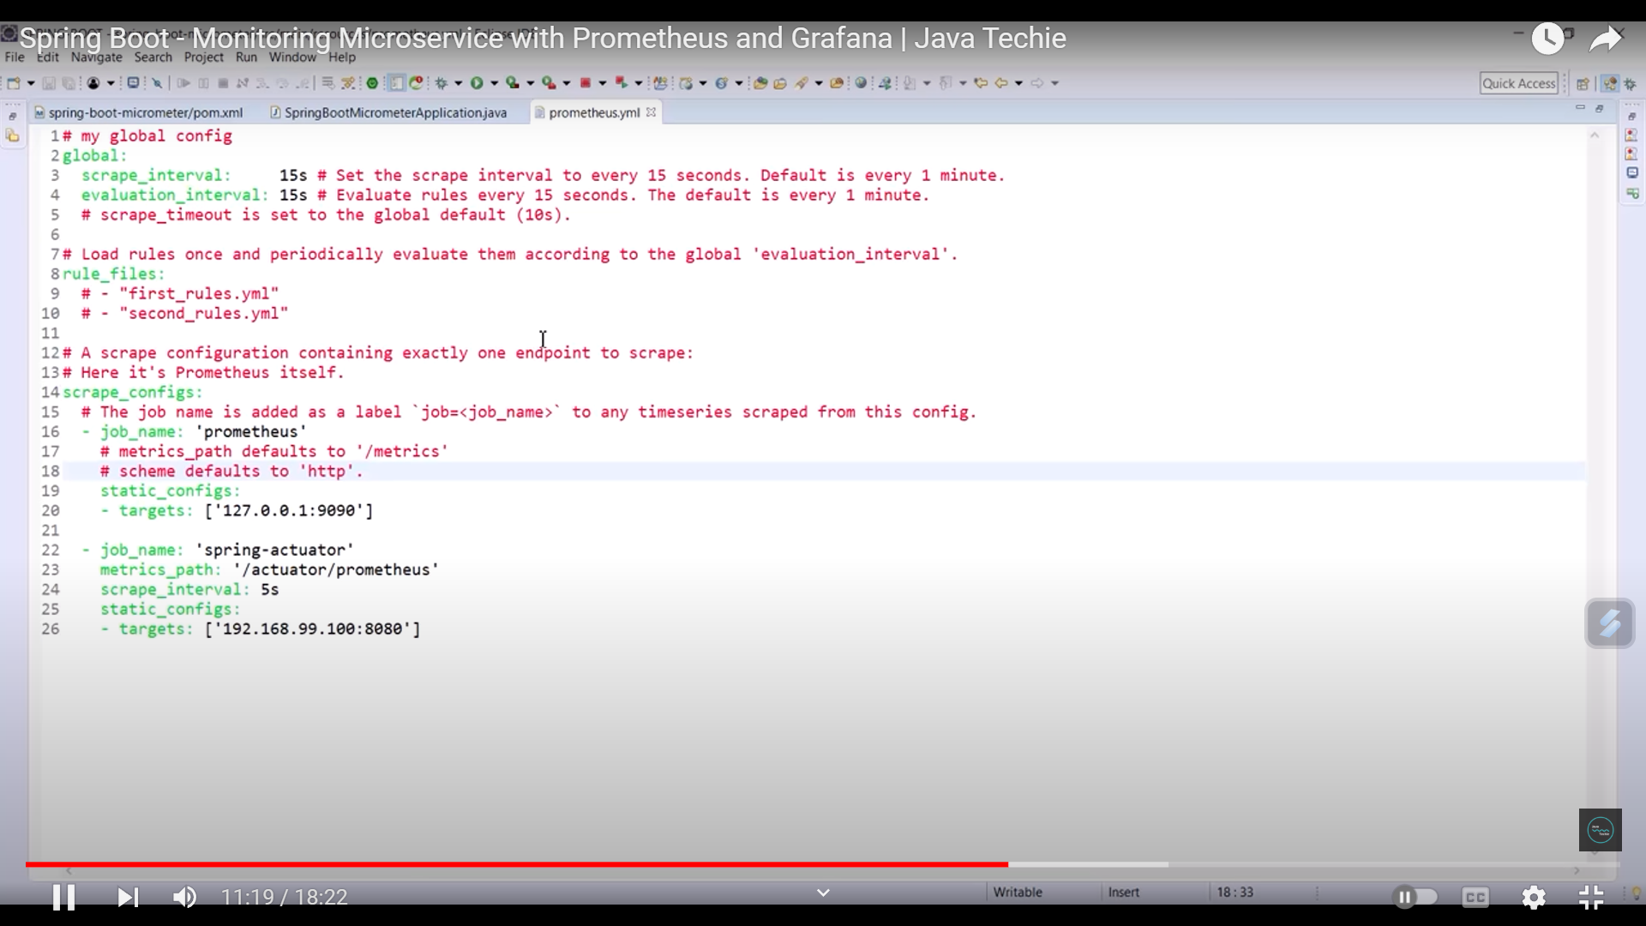

Slide 52
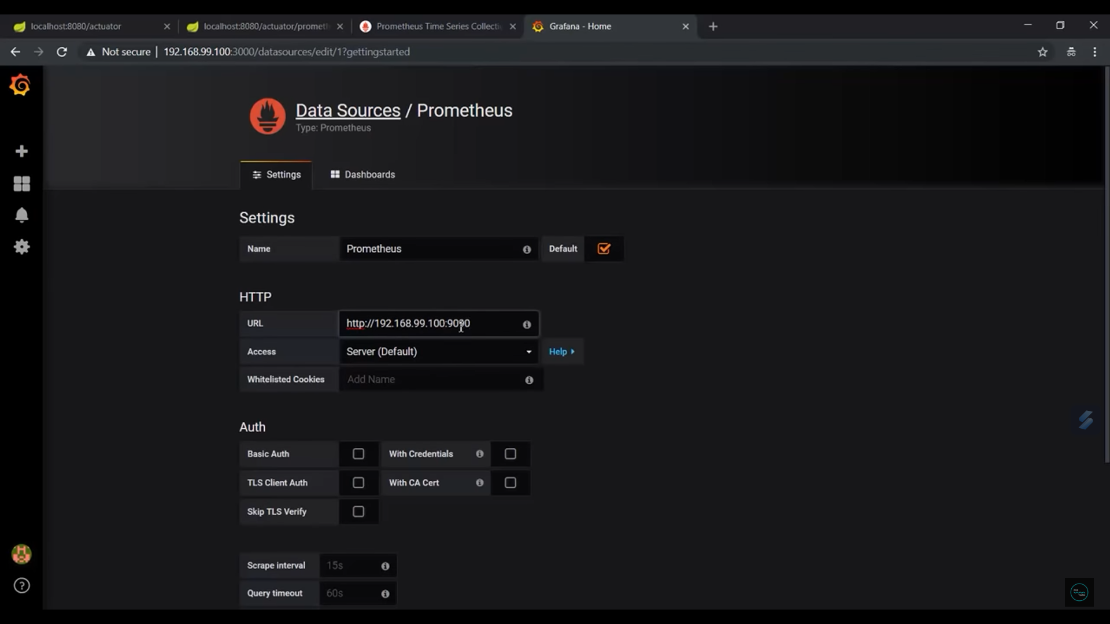

Slide 53
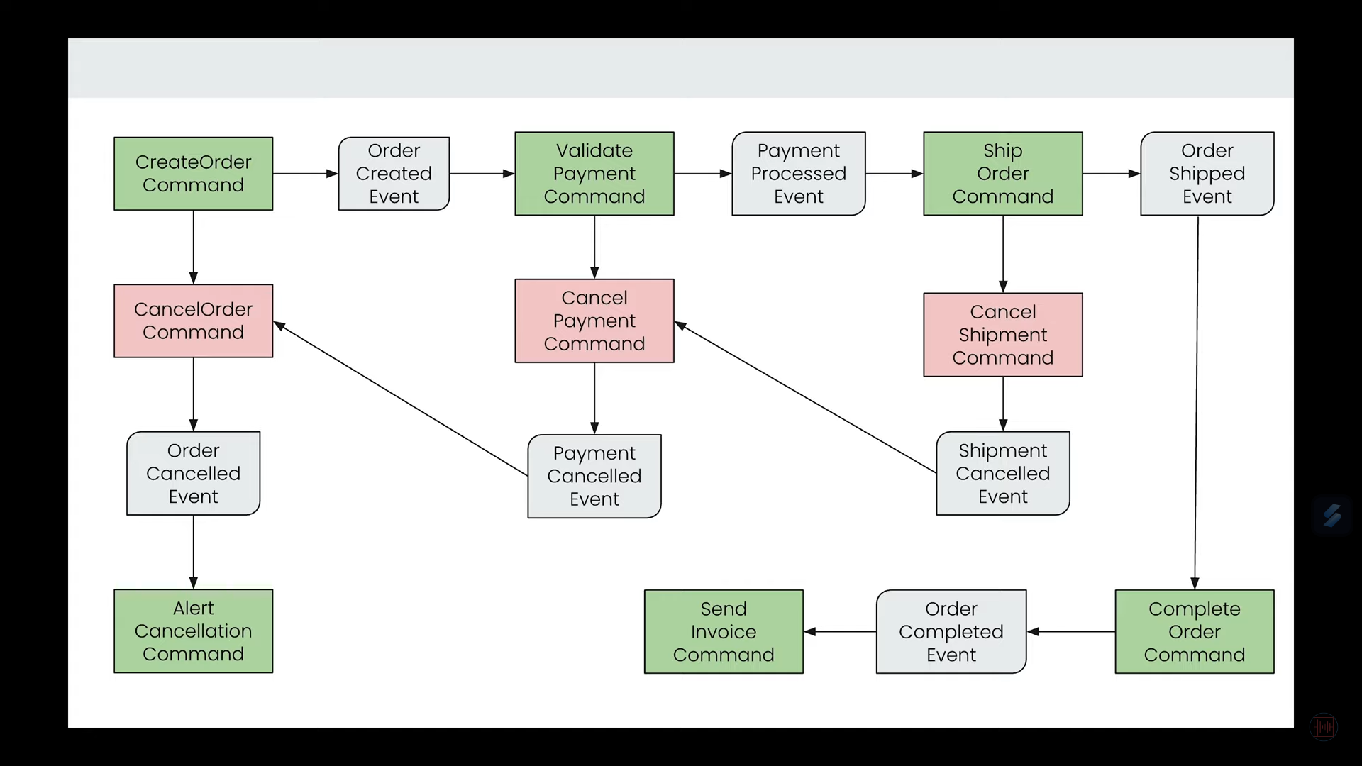
Saga Pattern

Slide 54
https://www.youtube.com/watch?v=PXkdFs2GSwE&list=PLq3uEqRnr_2EDsuxPboP9_WtVRR_TaMrF&index=3
https://www.youtube.com/watch?v=VO20SgiTTOU

